Slide 1

Similar as Alkenes
4) Aromatics
Vibration | Peak position (cm⁻¹) | More
ν _{=C－H} | 3000-3100
ν _{C=C} | 1450-1650 | 2-4 peaks
γ _{=C-H} | 650-900 | Substitution determination
γ _{=C-H} (multiple frequency) | 1600-2000 | Substitution determination

Slide 2
γ_{＝C－H} for ring substitution determination
H number Substitution γ_{＝C－H}(cm⁻¹)
5 Mono 770～730，710～690
4 ortho-di 770～735
4 meta-di 810～750，725～680
4 para-di 860～780
Book: Page 106

Slide 3
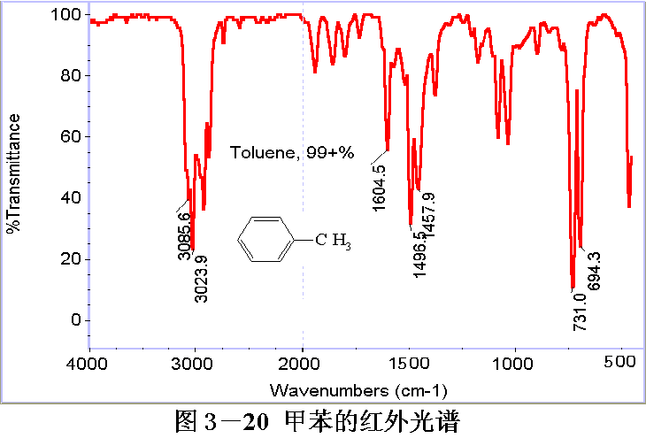
Toluene

Slide 4

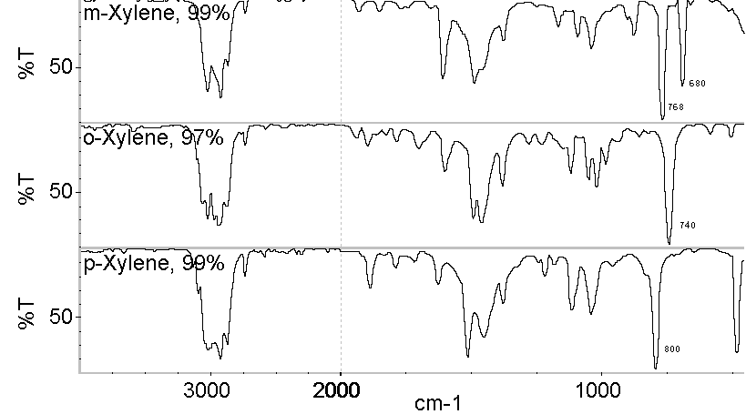
740
800
Ortho-/meta-/para- Xylenes
Notes:
相连的氢越多，振动频率越低，吸收强度越大。

Slide 5
5) Alcohol & Phenol
Vibration | Peak Position (cm⁻¹) | Peak Details
Isolated ν _{O-H} | 3600 | sharp, m
Associated ν _{O-H} | 3300 | br, s
ν _{C-O} | 1000-1250 Primary: 1050 Secondary: 1100 Tertiary: 1150 Phenol: 1200-1300 | s

Slide 6
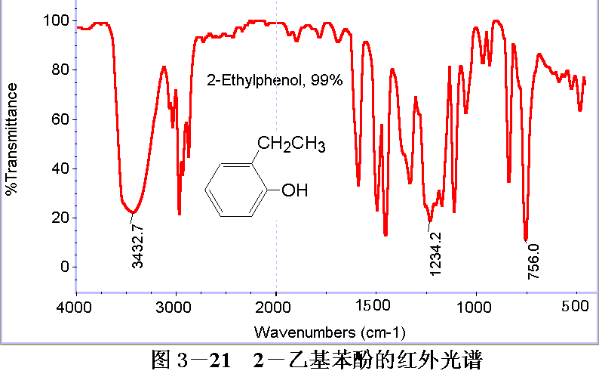
2-ethylphenol

Slide 7
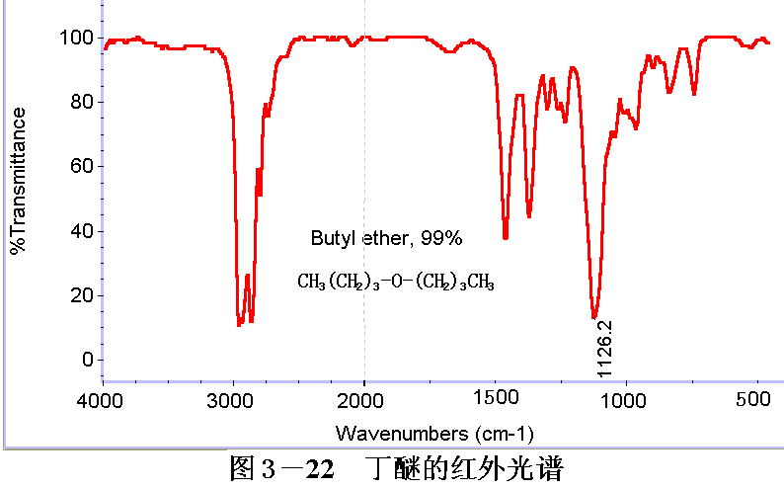
6. Ether
Aliphatic ether: υ_{C-O-C} = 1210-1000 cm ^{–1}
Aromatic ether: υ_{C-O-C} = 1200-1300 cm ^{–1}
υ_{C-O-C} = 1000-1055 cm ^{–1}
Butyl ether

Slide 8
7) Amine & Ammonium
Group | Characteristic Peaks (cm⁻¹)
Primary amine | 3300-3500 (d), 1560-1640, 650-900
Primary ammonium | ~3000 (broad), 1570-1600, 1500
Secondary amine | 3310-3350 (s), 1490-1580
Secondary ammonium | 2250-2700, 1570-1600
Tertiary amine | N/A
Quaternary amine | ν _{–N-H} red shift, 2250-2700

Slide 9
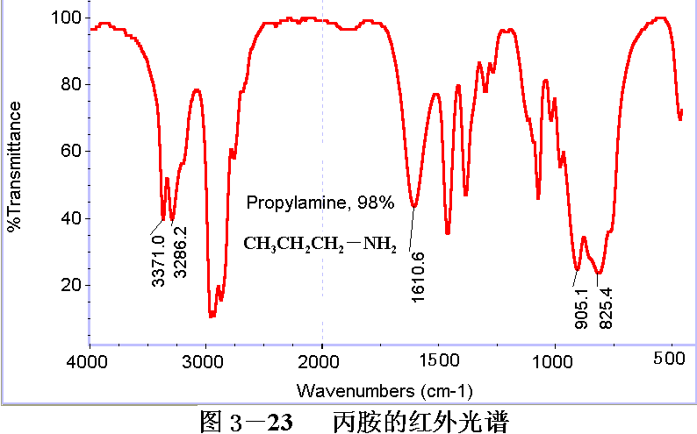
Propylamine
CH₃CH₂CH₂NH₂

Slide 10
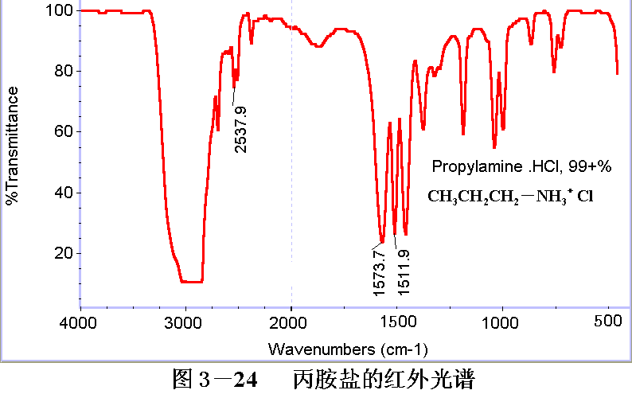
Propylammonium Chloride
CH₃CH₂CH₂NH₃＋Cl－

Slide 11
8) Nitrile
Group | ν _{–CN} (cm⁻¹) | Intensity
Aliphatic nitrile | 2200-2260 | Sharp and weak
Aromatic nitrile | 2200-2260 | Sharp and medium strong

